Slide 1
Image Caption Generation using Deep Neural Networks
2022 International Conference for Advancement in Technology (ICONAT)
By Sara Jerin Prithila (21101306)
Abid Hossain (ST)
Sania Azhmee Bhuiyan (RA)
1

Slide 2
Related Works
Generative-based method
and retrieval method.
Only Generative-based method cannot generate genuine novel captions.
Generative-based models is used to create novel captions for the images.
The show and Tell model
Uses a combination of LSTM cells and Inception version 3 (v3) model.
Datasets
Flickr8k dataset
8091 images

Slide 3

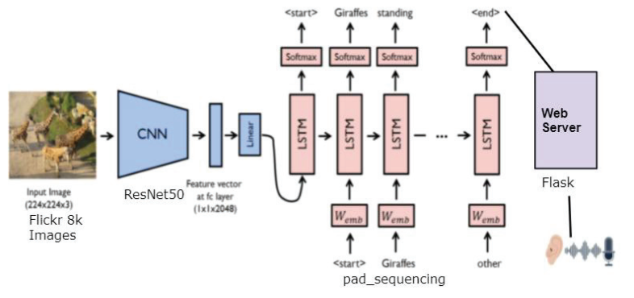
System Architecture
System architecture of image captioning model

Slide 4
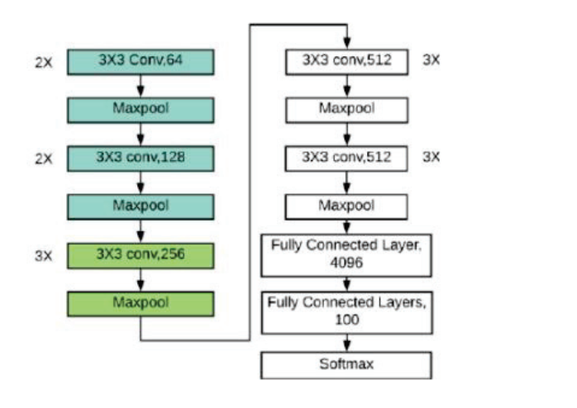


Training Procedure using VGG16
Training procedure using ResNet50
There are two kinds of residual connections:
I. The identity shortcuts when the input
and output are of the same dimensions
II. When the dimensions change
VGG16 Architecture layers

Slide 5
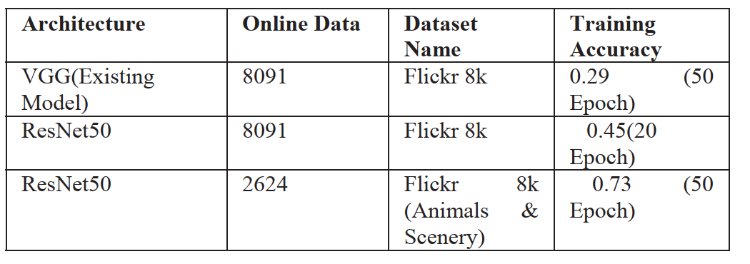
RESULTS & ACCURACY
Concludes that the ResNet50 achieves an average accuracy of 79%, which is more
accurate and better than VGG16 (29%).

Slide 6
Thank you for listening.

